Slide 1

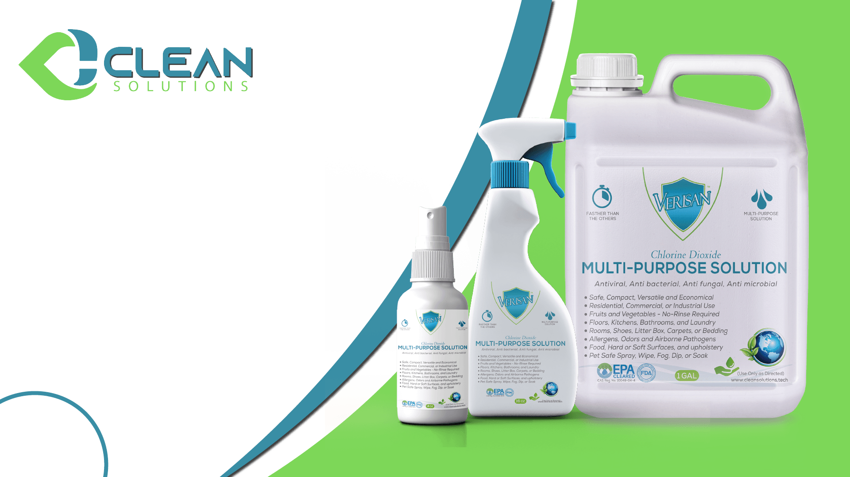
An Introduction to
VeriSan

Slide 2
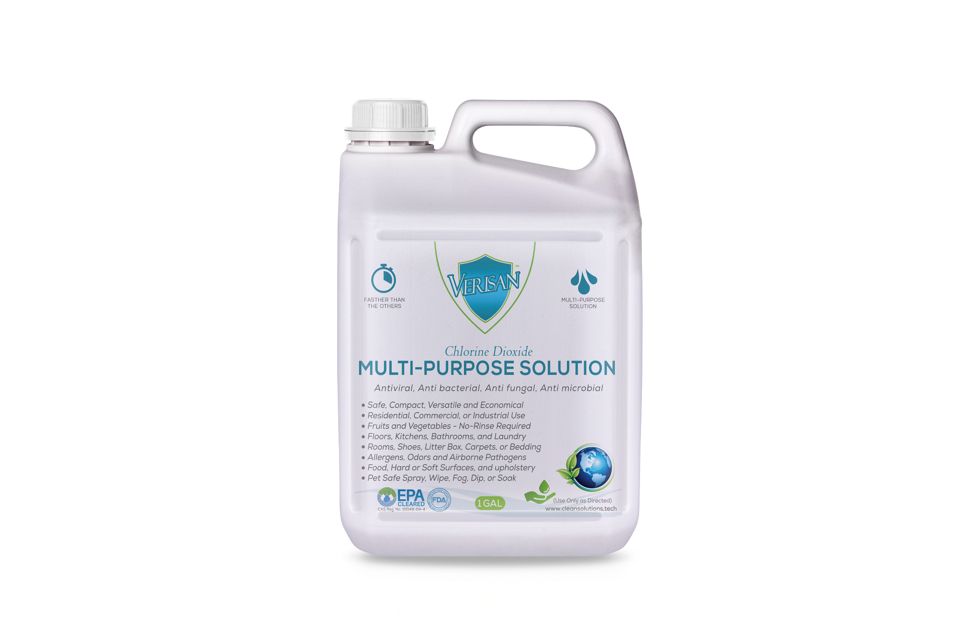

VeriSan
Would you like to stop worrying about germs?
Today’s world needs stronger and safer disinfecting options.
We pride ourselves in offering the most affordable and eco-friendly solutions in the industry. We use the highest quality and most effective components.
We stand by our products and promise that they are a far better alternative to what you are presently using.
EPA, NSF, FDA, CDC & FTC Cleared, OMRI, & NFPA Listed Components
No More Germs, No More Odor!

Slide 3
No Organism Tested Has Proven To Be Resilient
Kill 99.999% of ALL germs known to mankind.
Proven Active Against
Bacteria Virus Fungi Mold Mildew Spores Viruses Microbes Yeast Protozoa Parasites Mal-odor
Including
E. coli Salmonella Staphylococcus Streptococcus Parvoviruses
Avian Influenza. A H1N1, MRSA, HIV
Norovirus
Coronavirus Hepatitis A, B, & C Ebola virus
Over 200 others
Backed by medical science and made safe for civilian use.

Slide 4



Truly Versatile
Are you looking for a hand sanitizer that you can take with you on the road? Our reusable sprayers are convenient for travel and safe for sensitive skin.
For People
Sanitize anywhere you want to kill germs and odors. It’s also the perfect solution for hotels, restaurants, businesses, vehicles and public places.
For Places
You can disinfect and deodorize pet hair and litter-boxes, as well as, animal environments such as, kennels, stalls and enclosures.
For Pets
Disinfect your groceries for fresh and clean produce.
Safely sanitize fruits and vegetables with no rinse required!
For Food

Slide 5
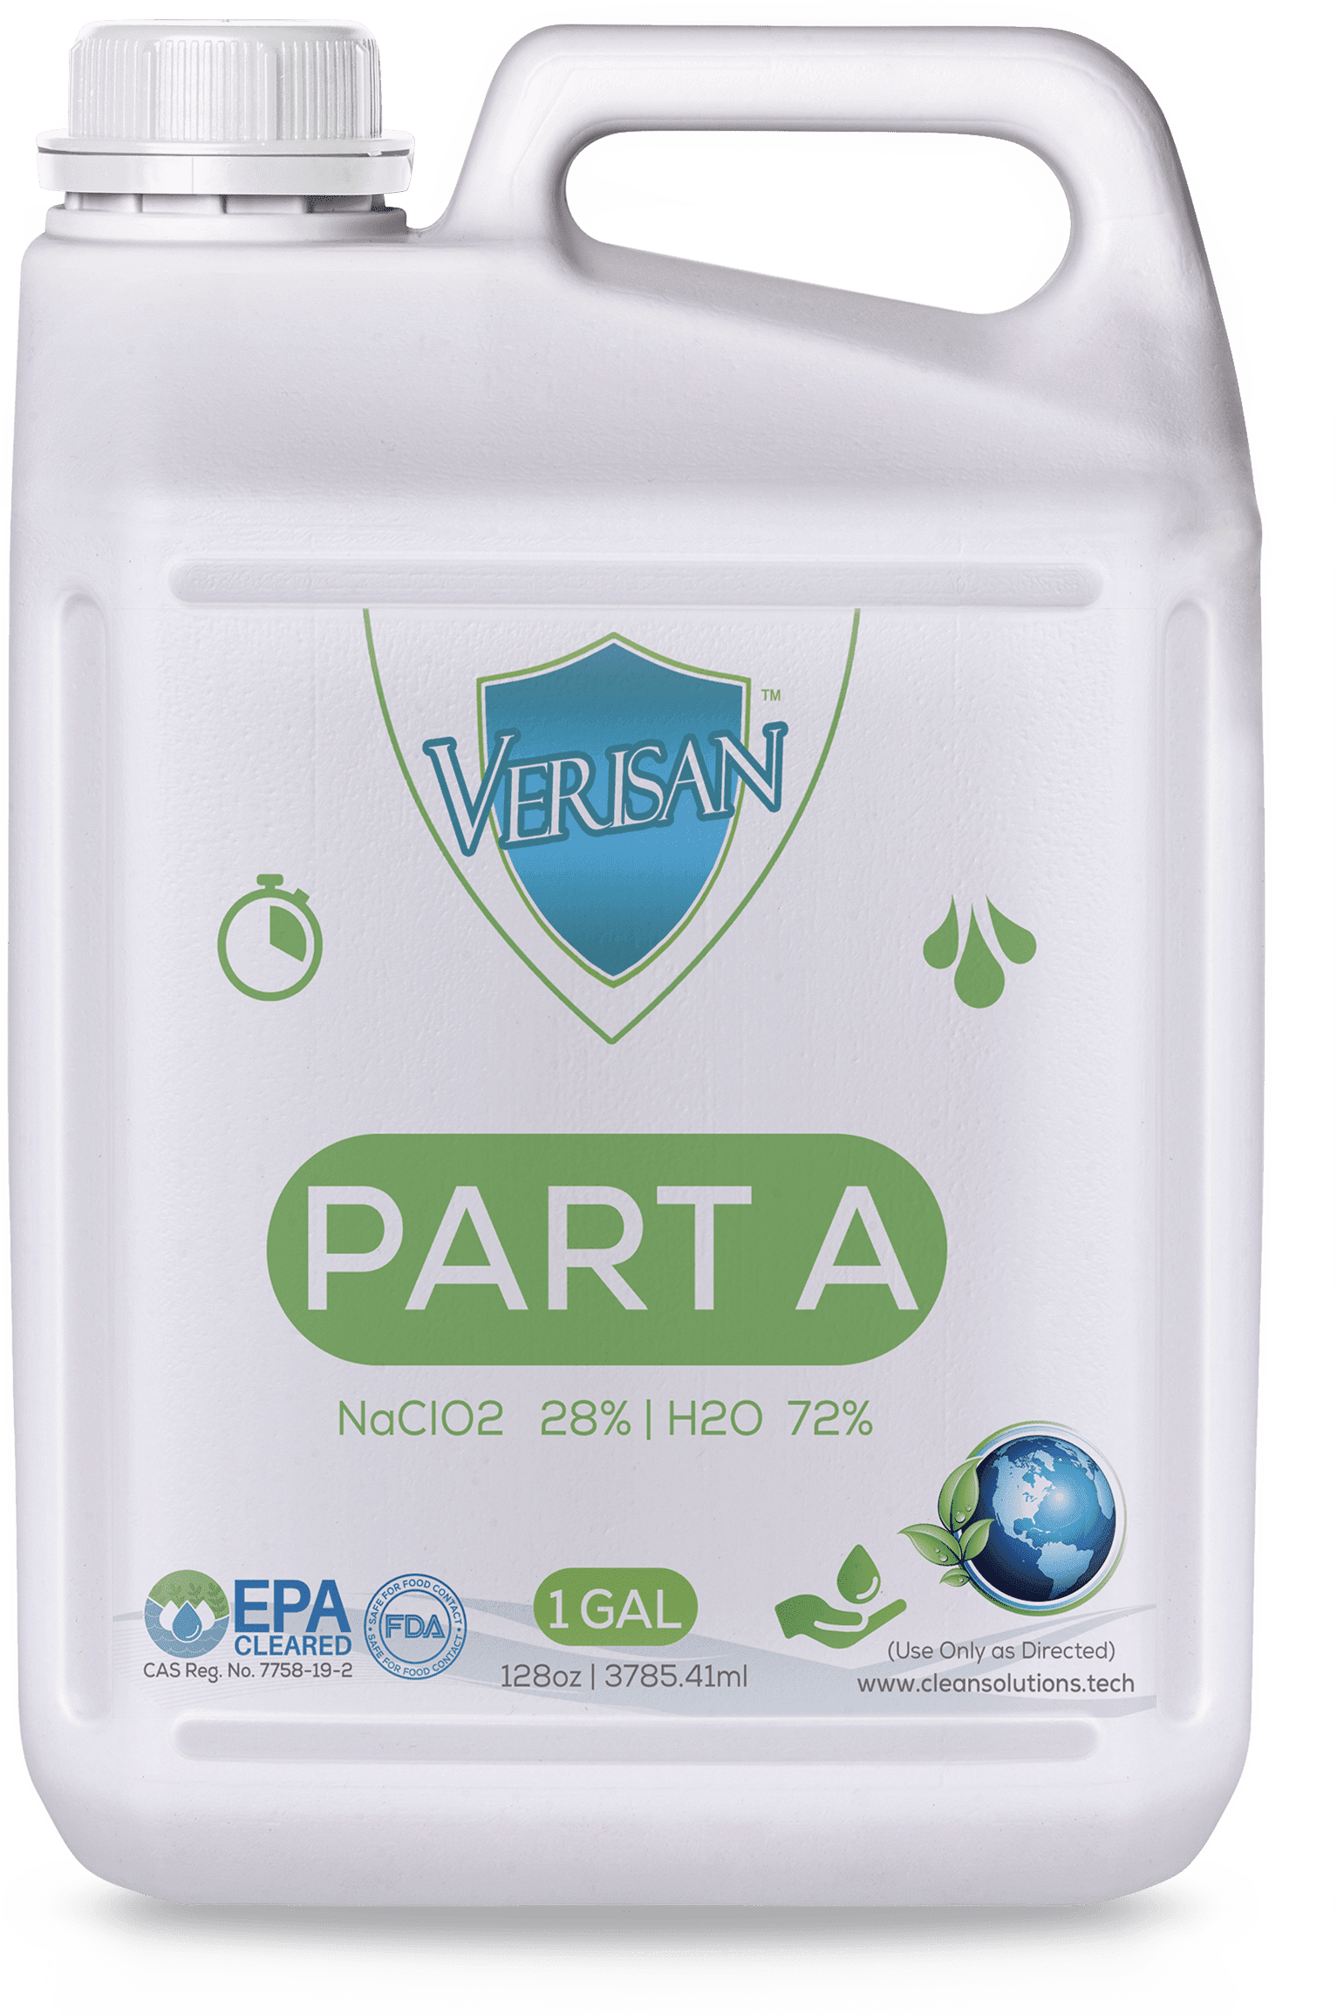
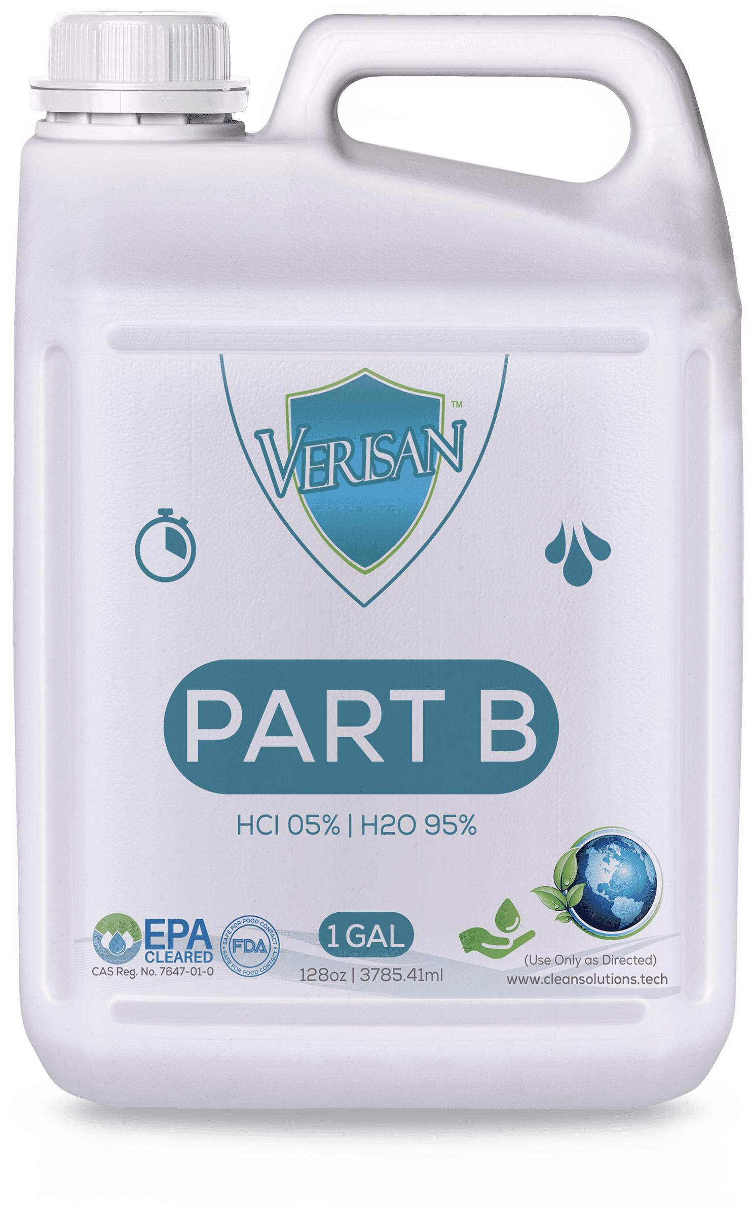
Your Lifetime Sanitizer Supply!
A Kit for Everything Clean!
Everything you need in a bulk sanitizer is right here.
Our custom kits make up to 10K gallons of product at a fraction of what you are currently paying.
INCLUDED
Part A and Part B
1 Reusable Mixing and Storage Container
1 Personalized User report
1 Instruction Manual
All Required Documentation

Slide 6
A Few Drops
IS ALL YOU NEED
Verisan Concentrate
Activator
Water
Sanitizer
Place a few drops of concentrate with a few drops of activator into a glass or plastic container.
Fill the rest of the container with water and then you’re good to go!

Slide 7

Sanitize Your Space
Give your businesses the deepest clean, at the most affordable price.
Residential Sanitizing
Business Sanitizing
Sanitize businesses inside & out.
VeriSan can be used as a vapor fogging service to disinfect every inch of your business.
Perfect for hotels, restaurants, fitness centers and high traffic areas.
Medical-Grade Sanitizing
Need a medical-grade cleaning?
Sanitize your schools, churches, farms, fleets, gyms, offices, hospitals or hotels.
Use a regular wipe down or vapor fogging to get the deepest clean possible.
Has your home been compromised?
Mold, Allergens, Germs, Odors?
It’s time for a deeper kind of clean. Our sanitizers kill any lingering germs and completely disinfect your home, top to bottom.

Slide 8
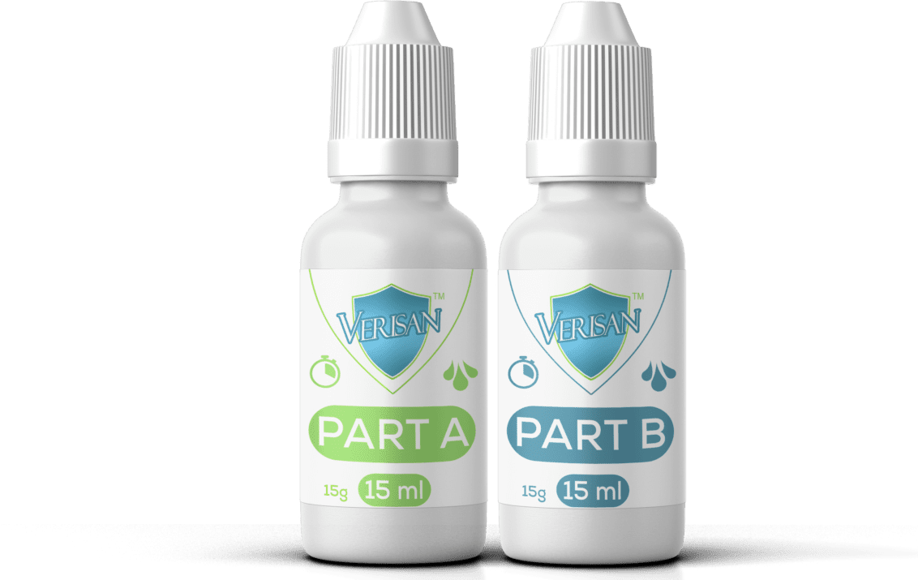

What’s Our Secret?
Chlorine Dioxide fights off bacteria and viruses killing 99.99% of all germs on contact.
Just the right balance!
Tough on germs and safe for you!
Chlorine Dioxide

Slide 9
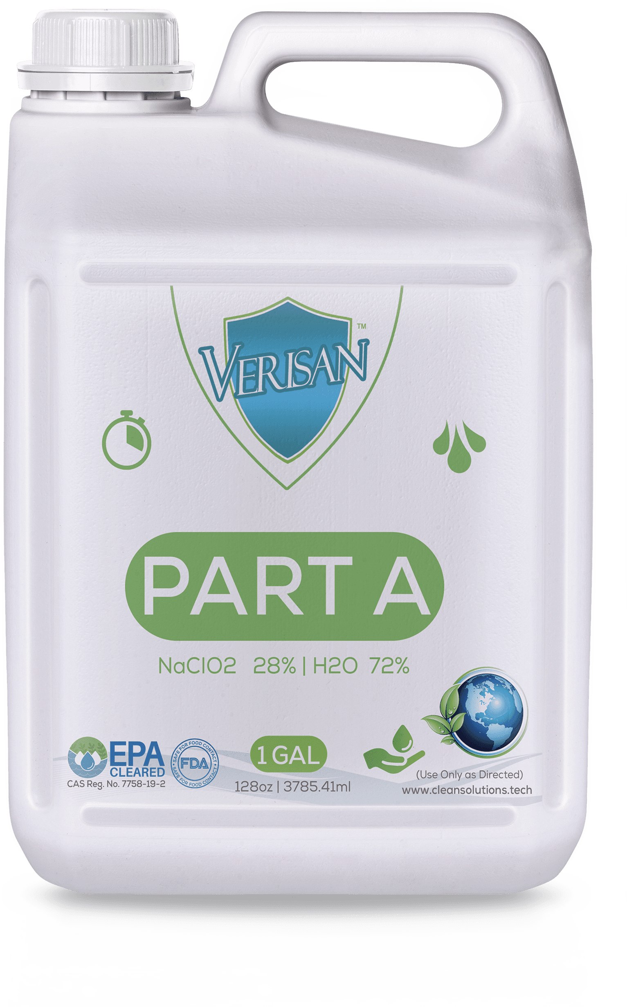
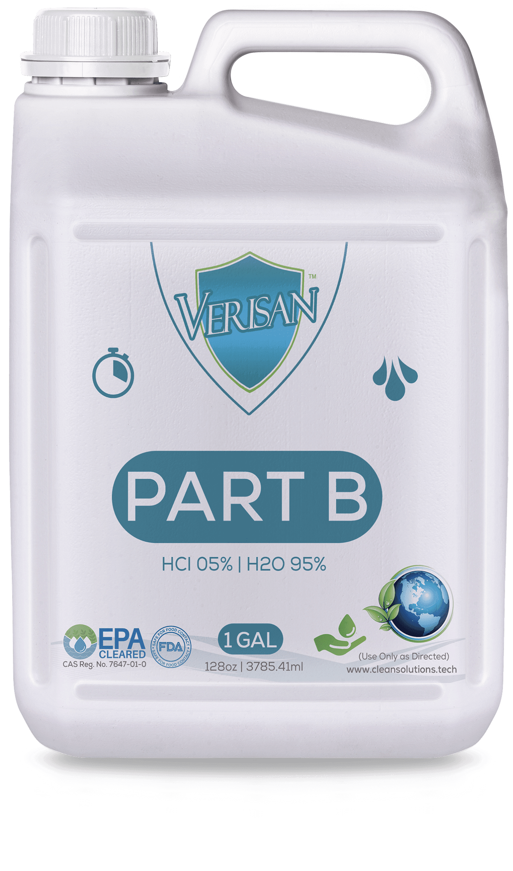
Why VeriSan?
Environment Friendly
We use Hypo-allergenic and environmentally friendly components.
LifeTime Supply
The last time you will ever
need to buy a disinfectant.
Our bulk sanitizer kits make up to 10K gallons!
Disinfect & Kill
Disinfects and kills 99.99% of bacteria, viruses and mold.
Odor Eliminator
No more germs, no more odor!

Slide 10

An Eco-Friendly Disinfectant?
Really?
We are committed to not only providing you with the strongest sanitizer on the market, but also the safest.
VeriSan is tough on germs but gentle on you and your environment.
Our unique kits can produce up to 10K gallons of safe and effective disinfectant.
We eliminate more than 98% of petroleum plastics and reduce shipping fees that result from purchasing gallons of conventional disinfectants.
Also, with each purchase, a contribution is made to oceanic rehabilitation.
It’s Your Turn Now!

Slide 11
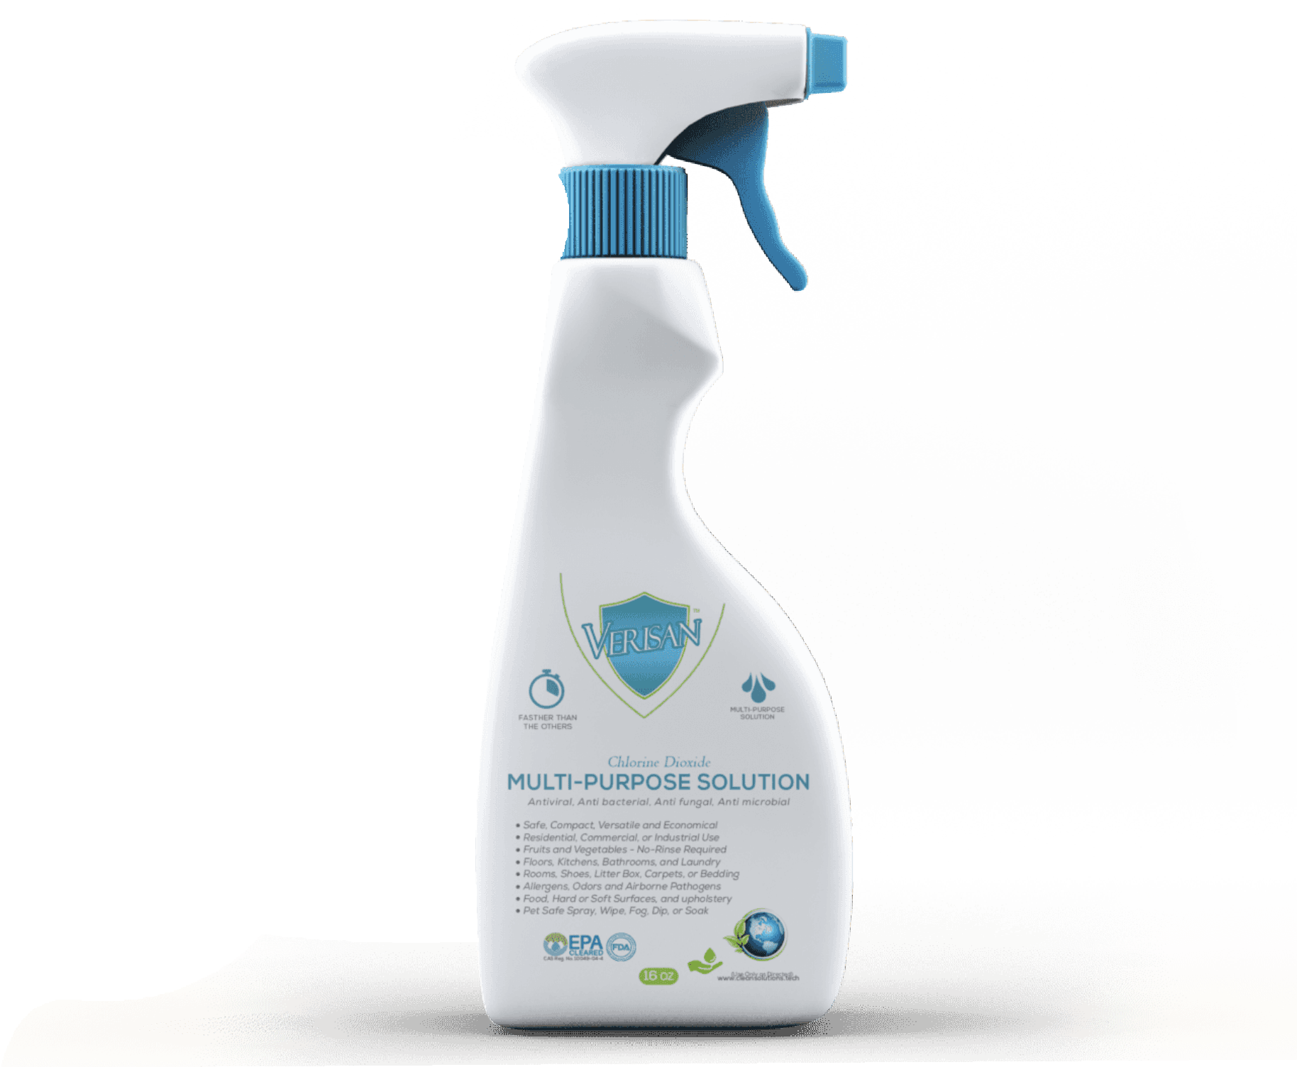








Applications & Uses
Drinking And Treating Water
Farm And Ranch
Pesticide & Insecticide
Home And Garden
Food Handling And Processing
Travel And Leisure
Medical Facilities
Commercial Use
Hvac And Mold Remediation
Skin Contact

Slide 12








Methods Of Use
Spray
Mop
Sponge
Swab
Fill
Flush
Immerse
Tanks
Tools

Slide 13
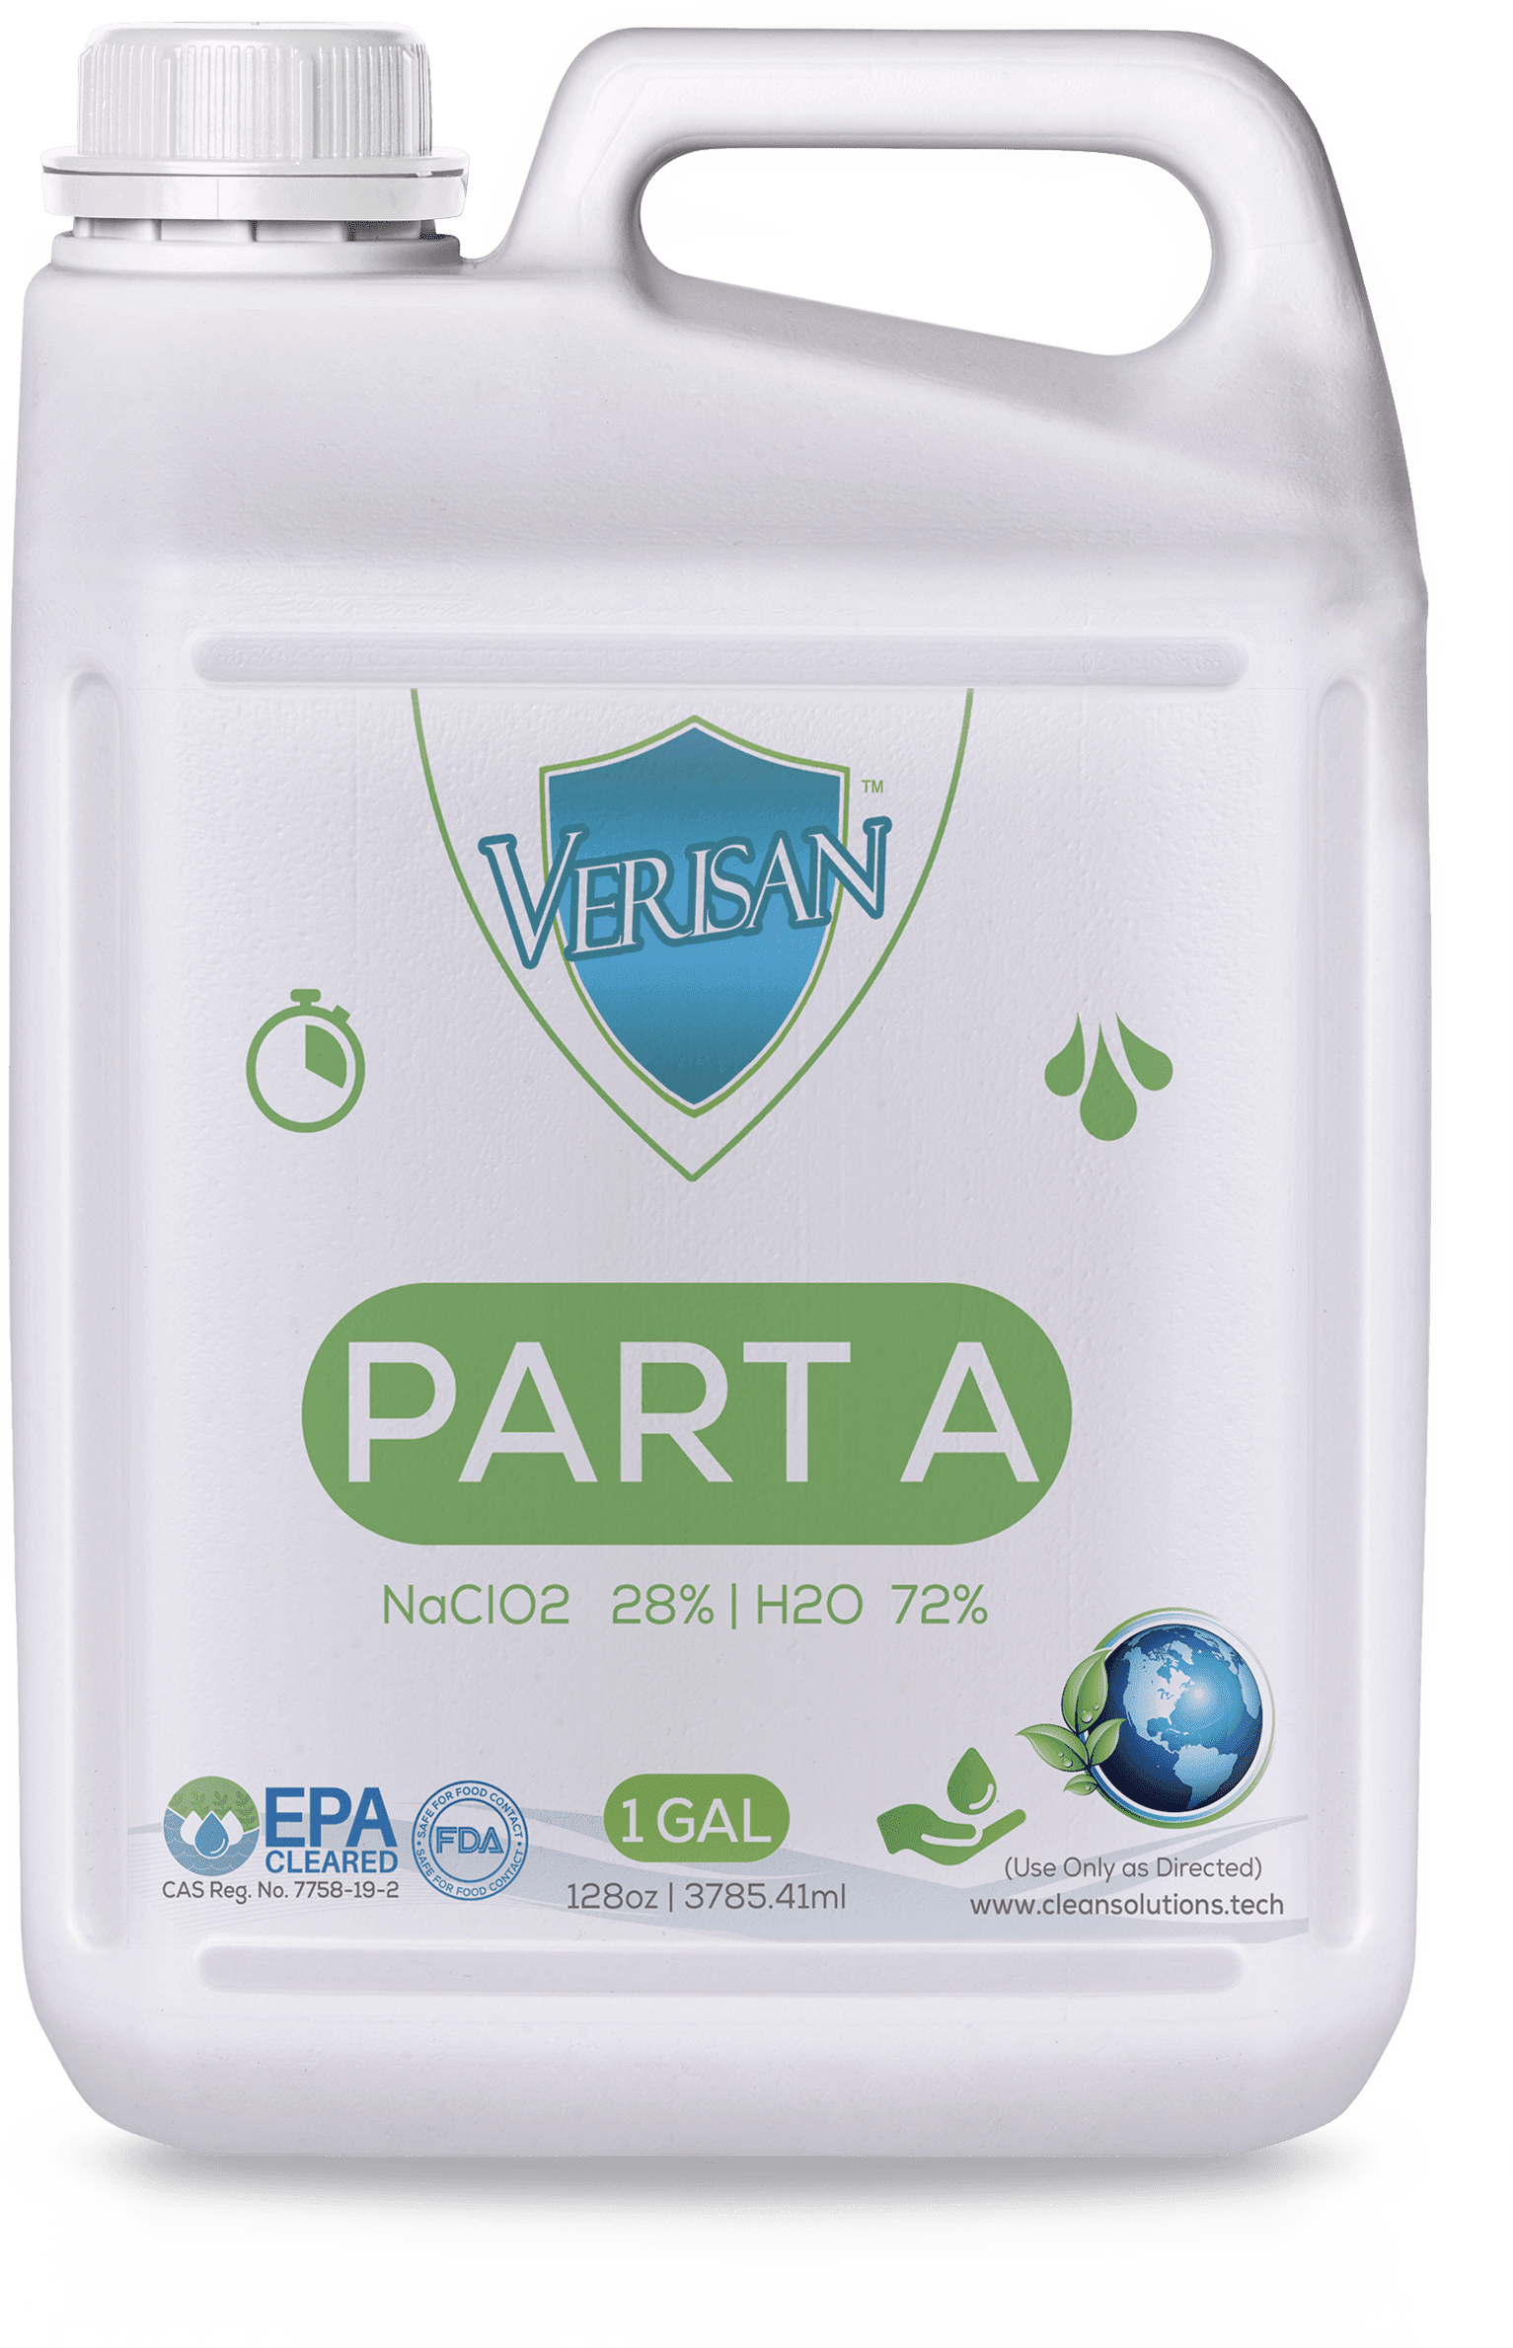
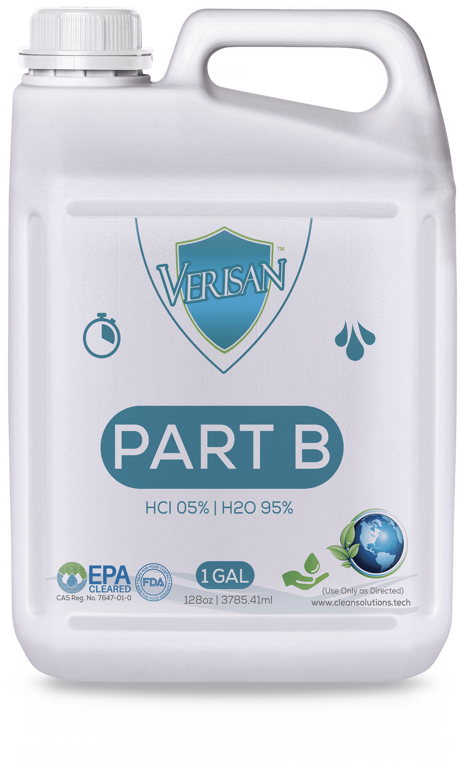
Costs Only 10% Of What You’re Used To
Get our bulk sanitizer for a fraction of the price of other brands
Today’s world needs stronger safer disinfecting solutions.
We pride ourselves in offering the highest quality, most effective, and safest products at the most affordable prices.
You won’t find a stronger or more cost-effective sanitizer on the market.

Slide 14
Our Automated Services
What we do today has an impact on our tomorrow.
Strategic and Custom Planning
EPA/DOT/NSF/ NFPA/GMPC
Crisis Training Intervention
Treat Environmental Toxins, and Allergens
We can design and install equipment that will automatically fog your business after hours.
Strategic Execution and Planning, System Applications, as well as, Product Design.
Our program provides security to your occupants and increased commercial productivity.
Our automated approach ensures thorough disinfection without any additional labor costs.

Slide 15
Our Services
We are living in a time where safety and sanitization are more important than ever
RESIDENTIAL SANITIZING
CONTINUITY PLANNING
HAZMAT & BIOHAZARD
PROJECT MANAGEMENT
BUSINESS CONSULTATION
CLASSES & TRAINING
BUSINESS SANITIZING
FIRE & FLOOD CLEANUP
MOLD REMEDIATION
ALLERGENS & PATHOGENS
DISASTER RELIEF AID
HOARDING & DECOMP
MEDICAL- DISINFECTION
VIRUS & BACTERIA FOGGING
HEPPA, HVAC & AIR QUALITY
AG & HORTICULTURE
VANDALISM CLEANUP
VANDALISM CLEANUP
Contact us today and see how we can help. Fast and affordable quotes for our consultation, disinfection, renovation or crisis response services.

Slide 16
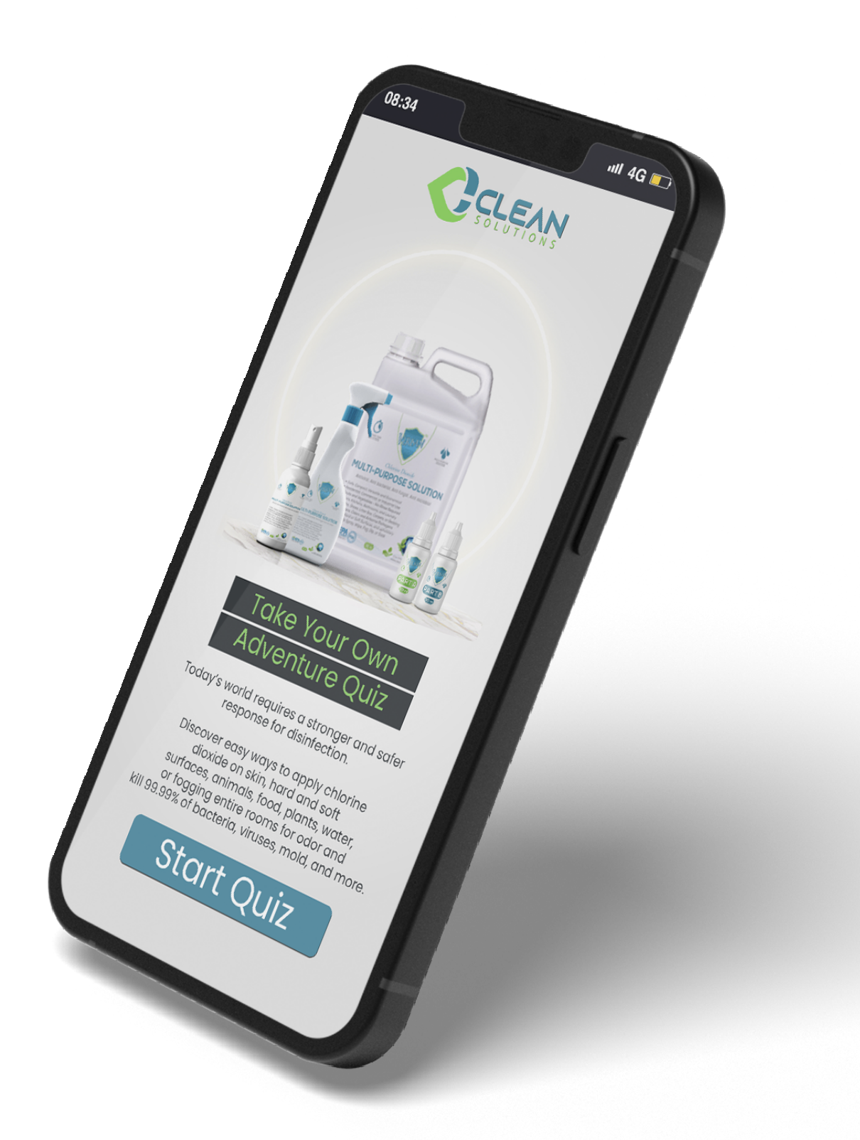
CONSULTATION
Discover easy ways to apply chlorine dioxide on skin, hard and soft surfaces, animals, food, plants and water. Learn to fog entire rooms for odor control and kill 99.99% of bacteria, viruses, mold, and more.
Contact us today and schedule a consultation for a customized product
or personalized service. It will be less expensive than you think!
Or, you can simply take our short questionnaire and help us design the perfect customized solution, just for you.

Slide 17
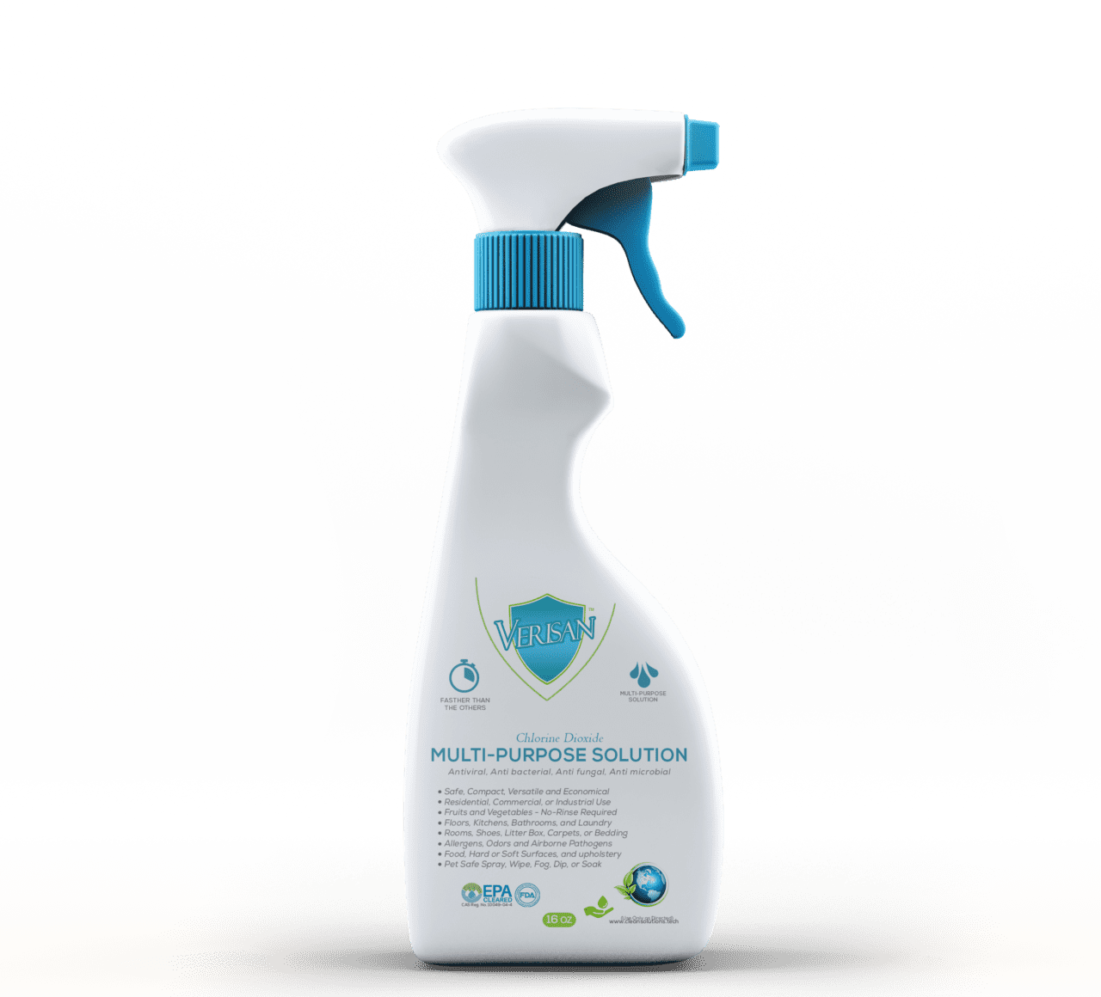




Applications & Uses
Treat Drinking Water
Home And Garden
Travel And Leisure
Commercial Use
Skin Contact

Slide 18






Industries VeriSan Caters To:
Farm and Ranch
Medical Facilities
Food Handling and Processing
Pesticide and Insecticide
Sports and
Fitness Facilities
HVAC and Mold Remediation
AND SO MANY MORE

Slide 19





How To Use Our Kits
Create your own custom solution to keep in your car or pocket.
Use the same solution to disinfect your household or business.
Sanitize your hands, laptop, countertop, phone, and anywhere you want to kill germs.
Mix A & B
Put a few drops of each, A
and B, into a glass or plastic container.
Wait
Set aside for one minute and wait for the solution to turn an amber color.
Fill
Now, add clean water to fill the rest of the container.
Ready To Go!
That’s it! You’re done.
Now you’re ready to sanitize, disinfect and deodorize.

